Slide 1

Presentation 1.2 The Technology Value Stream
Laura Kendl
Bellevue University
WEB 430-346A: DevOps (2227-DD)
Professor Richard Krasso
May 27, 2022

Slide 2

The Technology Value Stream | Objectives
This presentation will cover:
The Technology Value Stream
Lead Time
Processing Time
Common Development Scenarios
The DevOps Ideal
(pch.vector)

Slide 3
The Technology Value Stream

Slide 4
The Technology Value Stream
Brief Description
The technology value stream is
“
the process required to convert a business hypothesis into a technology-enabled service that delivers value to the customer
Put simply, the technology value stream is the entire process of taking a business request and creating the request.
”
(Kim et al., 2016, p. 8)

Slide 5

The Technology Value Stream | The Process
Step One
The process begins with an input:
a business objective,
(Kim et al., 2016, p. 8).
concept,
idea or hypothesis

Slide 6

The Technology Value Stream | The Process
Step Two
The Agile team transforms the input into user stories, feature specifications and creates the code.
(Kim et al., 2016, p. 8).

Slide 7
The Technology Value Stream | The Process
Step Three
The end-product is produced, using software versioning for future code updates
(Kim et al., 2016, p. 8).

Slide 8
The Technology Value Stream
Key Metrics
The technology value stream has three key metrics that measure its performance:
Lead Times
Processing Times
%C/A (percent complete and accurate)

Slide 9
DEFINING LEAD TIME VS. PROCESSING TIME

Slide 10

Defining Lead Time vs. Processing Time
Lead Time
Lead time is one tool to measure value stream performance (in addition to processing time)
(Kim et al., 2016, p. 9).
Lead time is the measure of time when a request is made and when the request is fulfilled
(Kim et al., 2016, p. 9).

Slide 11

Defining Lead Time vs. Processing Time
Processing Time
Processing time is the second tool that measures value stream performance.
Process time begins when the request is no longer queued, and the development of the customer's request begins (Kim et al., 2016, p. 9).

Slide 12
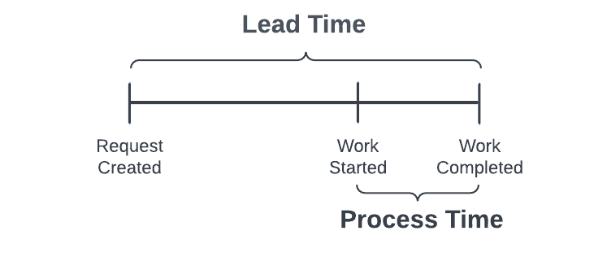
Defining Lead Time vs. Processing Time
Lead Time vs. Processing Time

Slide 13
Defining Lead Time vs. Processing Time
Key Takeaways
!
Most developers focus only on improving lead time.
However, focusing on the ratio of lead to process time is a greater measure of efficiency.
Reducing a project's wait time in a queue will achieve fast flow and short lead times.

Slide 14
THE COMMON SCENARIO

Slide 15

The Common Scenario
Too Much Time
Deployment lead times commonly require months-worth of time.
This is a common scenario when developing "tightly-coupled, monolithic applications" for "large, complex organizations" (Kim et al., 2016, p. 10).
This results in:
Broken code and code that doesn’t pass tests (from merging all dev team changes together)
Days or weeks to fix each problem
Poor customer outcome

Slide 16
The Common Scenario
Too Much Time
What is the solution?

Slide 17
THE DEVOPS IDEAL

Slide 18

The DevOps Ideal: Deployment Lead Time of Minutes
The DevOps Ideal
Developers get fast, constant feedback on their work, thus:
Developers can quickly implement changes to code
Time is reduced for code to go into production

Slide 19
The DevOps Ideal: Deployment Lead Time of Minutes
The Benefit of the DevOps Ideal
“
A "high degree of confidence that our changes will operate as designed in production and that any problems can be quickly detected and corrected”
”
(Kim et al., 2016, p. 10)

Slide 20
The DevOps Ideal: Deployment Lead Time of Minutes
The Process
Continuously check code changes into version control repository.
Perform automated and exploratory tests against code changes.
Deploy.
Repeat as needed.
Step One
Step Two
Step Three
Step Four
(Kim et al., 2016, p. 10)

Slide 21
The DevOps Ideal: Deployment Lead Time of Minutes
The Setup
The Optimal Environment to Achieve the DevOps Ideal
Modular architecture (I.e., Angular)
Well encapsulated
Loosely-coupled
Encapsulation is the "idea of bundling data and methods that work on that data within one unit" (Janssen, 2022).
"...where the individual components of an application are built independently from one another" (Cloud Native Glossary, 2021, para. 1).

Slide 22
The DevOps Ideal: Deployment Lead Time of Minutes
The Plan
Commit Stage
Measure deployment lead time in minutes.
Measure the %C/A
Automated Test
20 minutes
Exploratory Test
20 minutes
Production Deploy
Total cycle: 50 minutes
10 minutes
An example of a technology value stream with a lead time of minutes.

Slide 23
%C/A

Slide 24
%C/A
Brief Description
A metric used after deployment.
Stands for “percent complete and accurate"
The metric "reflects the frequency of complete and accurate information received for processing" (ITS, 2010).
%C/A measures the percentage of 'usable work' that is delivered to the customer and the accuracy of the end-product.
%C/A = (# Complete & Accurate / Total) * 100 (ITS, 2010)
%C/A

Slide 25
The Technology Value Stream
Summary
The Technology Value Stream describes the process of converting a business idea into a technology-enabled service.
The value stream has three metrics: Lead time (time project is idle in queue), process time (time project is actively in development and completed) & %C/A (measures percentage of 'usable work' and accuracy)
A common development scenario = months of lead time.
Short lead time = better value stream
DevOps can reduce lead time
The DevOps Ideal = Developers get fast, continuous feedback and code changes are checked, tested, and deployed

Slide 26
References
Cloud Native Glossary. (2021, September 29). Loosely coupled architecture. https://glossary.cncf.io/loosely_coupled_architecture/
ITS. (2010, December 14). Process improvement calculations & tools. https://mn.gov/admin/assets/measurement_calculations_tools_handout_tcm36-68670.pdf
Janssen, T. (2022, January 7). OOP concept for beginners: What is encapsulation. Stackify. https://stackify.com/oop-concept-for-beginners-what-is-encapsulation/
Kim, G., Humble, J., Debois, P. & Willis, J. (2016). The DevOps handbook. It Revolution Press.

